Slide 1
What is Word2Vec?
Traian Rebedea
Bucharest Machine Learning reading group

Slide 2
Intro
About n-grams: “simple models trained on huge amounts of data outperform complex systems trained on less data”
Solution: “possible to train more complex models on much larger data set, and they typically outperform the simple models”
Why? “neural network based language models significantly outperform N-gram models”
How? “distributed representations of words” (Hinton, 1986 – not discussed today)

Slide 3
Goal
“learning high-quality word vectors from huge data sets with billions of words, and with millions of words in the vocabulary”
Resulting word representations
Similar words tend to be close to each other
Words can have multiple degrees of similarity

Slide 4
Previous work
Representation of words as continuous vectors
Neural network language model (NNLM) (Bengio et al., 2003 – not discussed today)
Mikolov previously proposed (MSc thesis, PhD thesis, other papers) to first learn word vectors “using neural network with a single hidden layer” and then train the NNLM independently
Word2vec directly extends this work => “word vectors learned using a simple model”
These word vectors were useful in various NLP applications
Many architectures and models have been proposed for computing these word vectors (e.g. see Socher’s Stanford group work which resulted in GloVe - http://nlp.stanford.edu/projects/glove/)
“these architectures were significantly more computationally expensive for training than” word2vec (in 2013)

Slide 5
Model Architectures
Some “classic” NLP for estimating continuous representations of words
LSA (Latent Semantic Analysis)
LDA (Latent Dirichlet Allocation)
Distributed representations of words learned by neural networks outperform LSA on various tasks that require to preserve linear regularities among words
LDA is computationally expensive and cannot be trained on very large datasets

Slide 6
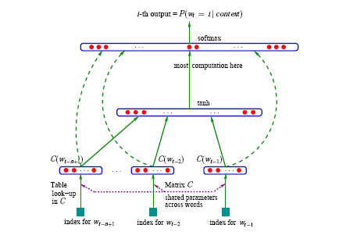

Model Architectures
Feedforward Neural Net Language Model (NNLM)

Slide 7
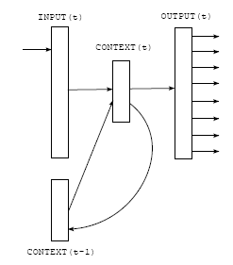
Model Architectures
Recurrent Neural Net Language Model (RNNLM)
Simple Elman RNN

Slide 8
Word2vec (log-linear) Models
Previous models - the complexity is in the non-linear hidden layer of the model
Explore simpler models
Not able to represent the data as precisely as NN
Can be trained on more data
In earlier works, Mikolov found that “neural network language model can be successfully trained in two steps”:
Continuous word vectors are learned using simple model
The N-gram NNLM is trained on top of these distributed representations of words

Slide 9
Continuous BoW (CBOW) Model
Similar to the feedforward NNLM, but
Non-linear hidden layer removed
Projection layer shared for all words
Not just the projection matrix
Thus, all words get projected into the same position
Their vectors are just averaged
Called CBOW (continuous BoW) because the order of the words is lost
Another modification is to use words from past and from future (window centered on current word)

Slide 10
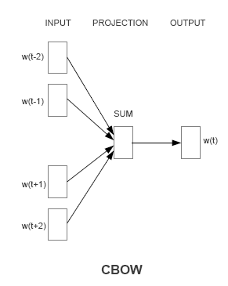
CBOW Model

Slide 11
Continuous Skip-gram Model
Similar to CBOW, but instead of predicting the current word based on the context
Tries to maximize classification of a word based on another word in the same sentence
Thus, uses each current word as an input to a log-linear classifier
Predicts words within a certain window
Observations
Larger window size => better quality of the resulting word vectors, higher training time
More distant words are usually less related to the current word than those close to it
Give less weight to the distant words by sampling less from those words in the training examples

Slide 12
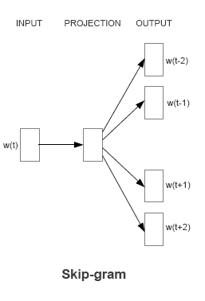
Continuous Skip-gram Model

Slide 13
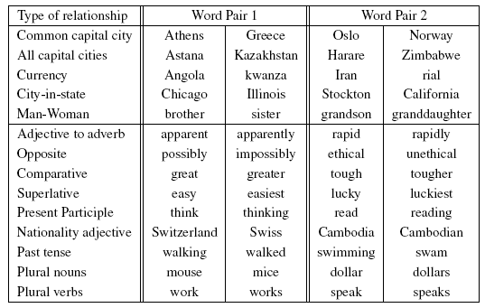
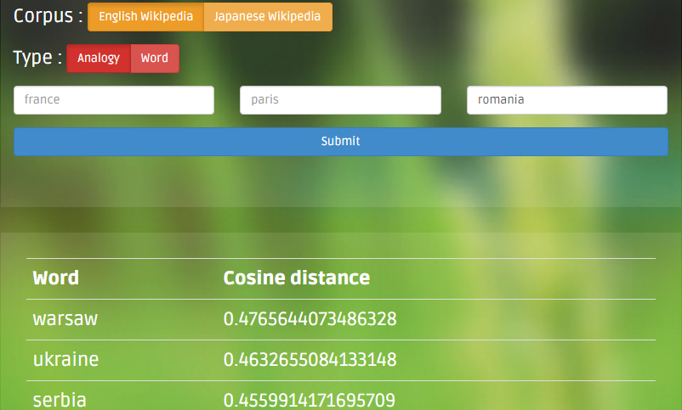
Results
Training high dimensional word vectors on a large amount of data captures “subtle semantic relationships between words”
Mikolov has made a similar observation for the previous models he has proposed (e.g. the RNN model, see Mikolov, T., Yih, W. T., & Zweig, G. (2013, June). Linguistic Regularities in Continuous Space Word Representations. In HLT-NAACL (pp. 746-751).)

Slide 14
Results
“Comprehensive test set that contains five types of semantic questions, and nine types of syntactic questions”
8869 semantic questions
10675 syntactic questions
E.g. “For example, we made a list of 68 large American cities and the states they belong to, and formed about 2.5K questions by picking two word pairs at random.”
Methodology
Input: ”What is the word that is similar to small in the same sense as biggest is similar to big?”
Compute: X = vector("biggest") – vector("big") + vector("small") and then find closest word to X using cosine

Slide 15
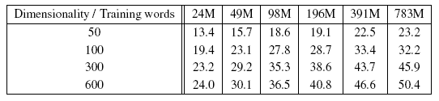
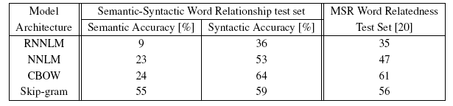
Results
Other results are reported as well

Slide 16

Skip-gram Revisited
Formally, the skip-gram model proposes that for a give sequence of words to maximize:
Where T = size of the sequence (or number of words considered for training)
c = window/context size
Mikolov, also says that for each word the model only uses a random window size r = random(1..c)
This way words that are closer to the “input” word have a higher probability of being used in training than words that are more distant

Slide 17

Skip-gram Revisited
As already seen, p(w_{t+j}|w_{t}) should be the output of a classifier (e.g. softmax)
w_{I} is the “input” vector representation of word w
w_{O} is the “output” (or “context”) vector representation of word w
Computing log p(w_{O}|w_{I}) takes O(W) time, where W is the vocabulary dimension

Slide 18



Skip-gram Alternative View
Training
Where
Getting to

Slide 19
Skip-gram Improvements
Hierarchical softmax
Negative sampling
Subsampling of frequent words

Slide 20
Hierarchical Softmax
Computationally efficient approximation of the softmax
When W output nodes, need to evaluate only about log(W) nodes to obtain the softmax probability distribution

Slide 21

Negative Sampling
Noise Contrastive Estimation (NCE) is an alternative to hierarchical softmax
NCE – “a good model should be able to differentiate data from noise by means of logistic regression”
“While NCE can be shown to approximately maximize the log probability of the softmax, the Skip-gram model is only concerned with learning high-quality vector representations, so we are free to simplify NCE as long as the vector representations retain their quality. We define Negative sampling (NEG) by the objective”:

Slide 22

Subsampling of Frequent Words
Frequent words provide less information value than the rare words
“More, the vector representations of frequent words do not change significantly after training on several million examples”
Each word w_{i} in the training set is discarded with a probability depending on the frequency of the word
Notes:
Where t=10^-5, chosen empiricaly

Slide 23


Other remarks
Mikolov also developed a method to extract relevant n-grams (bigrams and trigrams) using something similar to PMI
Effects of improvements
Vectors can also be summed

Slide 24
Other Applications
Dependency-based contexts
Word2vec for machine learning translation

Slide 25
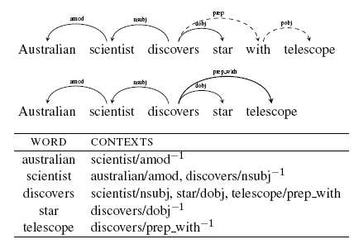
Dependency-based Contexts
Levi and Goldberg, 2014: Propose to use dependency-based contexts instead of linear BoW (windows of size k)

Slide 26
Dependency-based Contexts
Why?
Syntactic dependencies are “more inclusive and more focused” than BoW
Capture relations to words that are far apart and that are not used by small window BoW
Remove “coincidental contexts which are within the window but not directly related to the target word”
A possible problem
Dependency parsing is still somewhat computational expensive
However, English Wikipedia can be parsed on a small cluster and the results can then be persisted

Slide 27
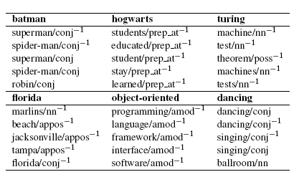
Dependency-based Contexts
Examples of syntactic contexts

Slide 28
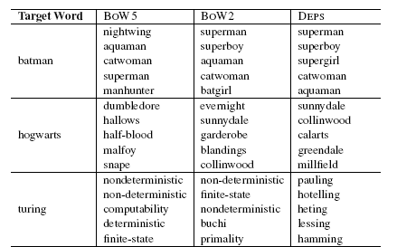
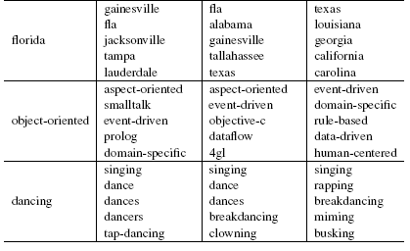
Dependency-based Contexts
Comparison with BoW word2vec

Slide 29
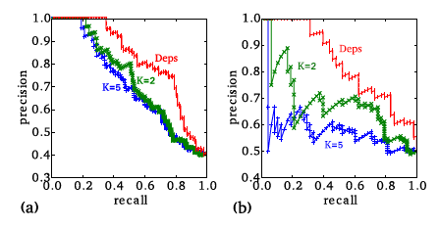
Dependency-based Contexts
Evaluation on the WordSim353 dataset with pairs of similar words
Relatedness (topical similarity)
Similarity (functional similarity)
Both (these pairs have been ignored)
Task: “rank the similar pairs in the dataset above the related ones”
Simple ranking: Pairs ranked by cosine similarity of the embedded words

Slide 30
Dependency-based Contexts
Main conclusion
Dependency-based context is more useful to capture functional similarities (e.g. similarity) between words
Linear BoW context is more useful to capture topical similarities (e.g. relatedness) between words
The larger the size of the window, the better it captures related concepts
Therefore, dependency-based contexts would perform poorly in analogy experiments

Slide 31

Estimating Similarities Across Languages
Given a set of word pairs in two languages (or different types of corpora) and their associated vector representations (x_{i} and z_{i})
They can have even different dimensions (d₁ and d₂)
Find a transformation matrix, W(d₂, d₁), such that Wx_{i} approximates as close as possible z_{i}, for all pairs i
Solved using stochastic gradient descent
The transformation is seen as a linear transformation (rotation and scaling) between the two spaces

Slide 32
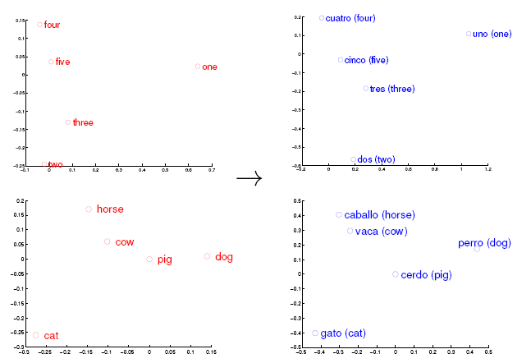
Estimating Similarities Across Languages
Authors also highlight this using a manual rotation (between En and Sp) and a visualization with 2D-PCA

Slide 33
Estimating Similarities Across Languages
The most frequent 5K words from the source language and their translations given GT – training data for learning the Translation Matrix
Subsequent 1K words in the source language and their translations are used as a test set

Slide 34
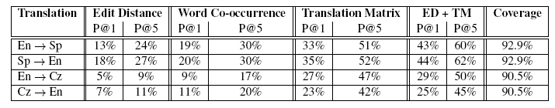
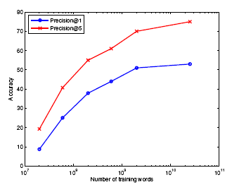
Estimating Similarities Across Languages
Very simple baselines

Slide 35
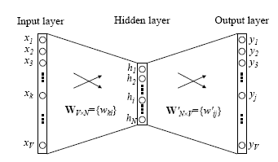



More Explanations
CBOW model with a single input word

Slide 36







Update Equations
Maximize the conditional probability of observing the actual output word w_{O} (denote its index in the output layer as j) given the input context word w_{I} with regard to the weights

Slide 37
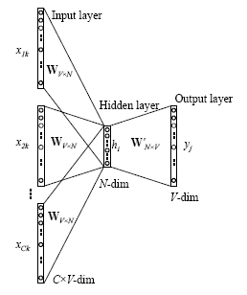

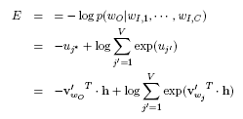


CBOW with Larger Context

Slide 38
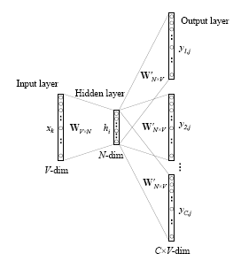

Skip-gram Model
Context and input word have changed order

Slide 39
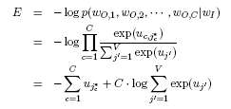






Skip-gram Model

Slide 40

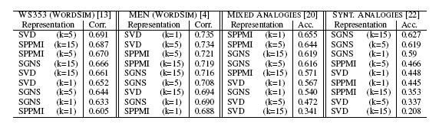
More…
Why does word2vec work?
It seems that SGNS (skip-gram negative sampling) is actually performing a (weighted) implicit matrix factorization
The matrix is using the PMI between words and contexts
PMI and implicit matrix factorizations have been widely used in NLP
It is interesting that the PMI matrix emerges as the optimal solution for SGNS’s objective

Slide 41
Final
“PMI matrices are commonly used by the traditional approach to represent words (often dubbed "distributional semantics"). What's really striking about this discovery, is that word2vec (specifically, SGNS) is doing something very similar to what the NLP community has been doing for about 20 years; it's just doing it really well.”
Omer Levy - http://www.quora.com/How-does-word2vec-work

Slide 42
References
Word2vec & related papers:
Mikolov, T., Chen, K., Corrado, G., & Dean, J. (2013). Efficient estimation of word representations in vector space. arXiv preprint arXiv:1301.3781.
Mikolov, T., Sutskever, I., Chen, K., Corrado, G. S., & Dean, J. (2013). Distributed representations of words and phrases and their compositionality. In Advances in neural information processing systems (pp. 3111-3119).
Mikolov, T., Yih, W. T., & Zweig, G. (2013, June). Linguistic Regularities in Continuous Space Word Representations. In HLT-NAACL (pp. 746-751).
Explanations
Rong, X. (2014). word2vec Parameter Learning Explained. arXiv preprint arXiv:1411.2738.
Goldberg, Y., & Levy, O. (2014). word2vec Explained: deriving Mikolov et al.'s negative-sampling word-embedding method. arXiv preprint arXiv:1402.3722.
Levy, O., & Goldberg, Y. (2014). Neural word embedding as implicit matrix factorization. In Advances in Neural Information Processing Systems (pp. 2177-2185).
Dyer, C. (2014). Notes on Noise Contrastive Estimation and Negative Sampling. arXiv preprint arXiv:1410.8251.
Applications of word2vec
Mikolov, T., Le, Q. V., & Sutskever, I. (2013). Exploiting similarities among languages for machine translation. arXiv preprint arXiv:1309.4168.
Levy, O., & Goldberg, Y. (2014). Dependency based word embeddings. In Proceedings of the 52nd Annual Meeting of the Association for Computational Linguistics (Vol. 2, pp. 302-308).

